Slide 1
Project Management Process

Slide 2
Objectives
What is done during each of the project management process groups
Initiating
Planning
Executing
Monitoring and Controlling
Closing
What you do not do but should do in your real world during each of the project management process groups.

Slide 3
Content
49 Processes
– Type of processes
5 Process Groups
Initiating
Planning
Executing
Monitoring & Controlling
Closing
10 Knowledge Areas

Slide 4
1. 49 Processes

Slide 5
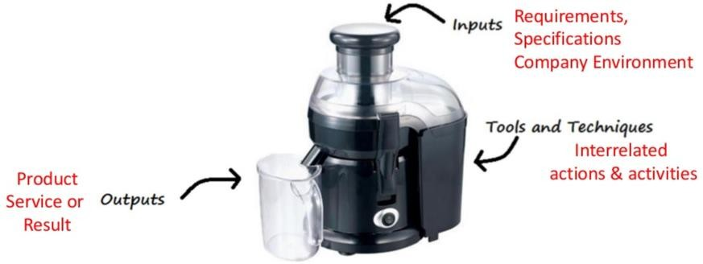
Overview
A set of interrelated actions & activities performed to
create a pre-specified product, service or result

Slide 6
Overview
For project to be successful, Project team should:
Select appropriate processes as per project objective
Use defined approach that can be adapted to meet requirements
Establish & maintain communication & engagement with
stakeholders
Comply with requirement to meet stakeholder needs and expectations
Balance competing constraints

Slide 7
Type of Process
Project Management Processes
Ensure effective flow of Project throughout its life cycle
Encompasses Tools & techniques involved in applying skills & capabilities
Product Oriented Processes
Specify & create projects product.
Defined by product life cycle and vary by application area as well as phases of the project life cycle

Slide 8
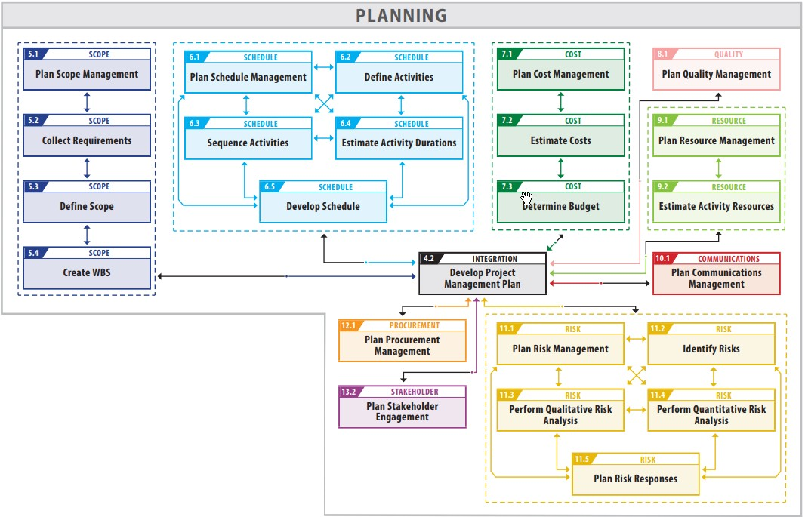
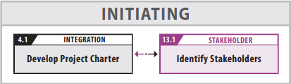
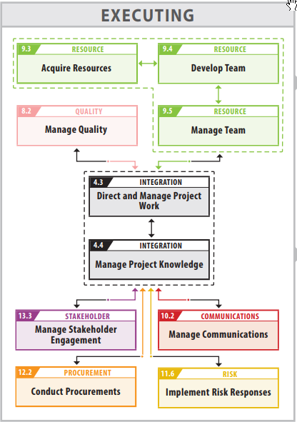
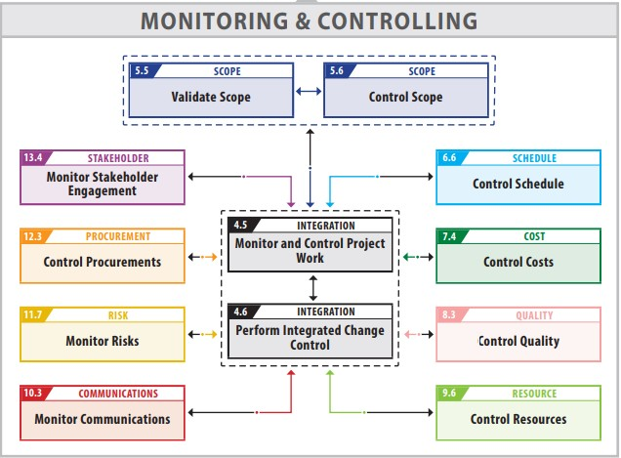

49 Processes of PMI

Slide 9
2. 5 Process Groups

Slide 10
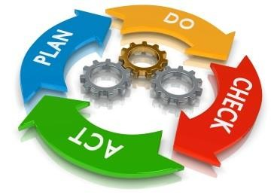
Overview
A logical grouping of project management inputs, tools and techniques, and outputs
Initiating (Start)
Planning (Plan)
Executing (Do)
Monitoring & Controlling (Check – Act)
Closing (Stop)

Slide 11
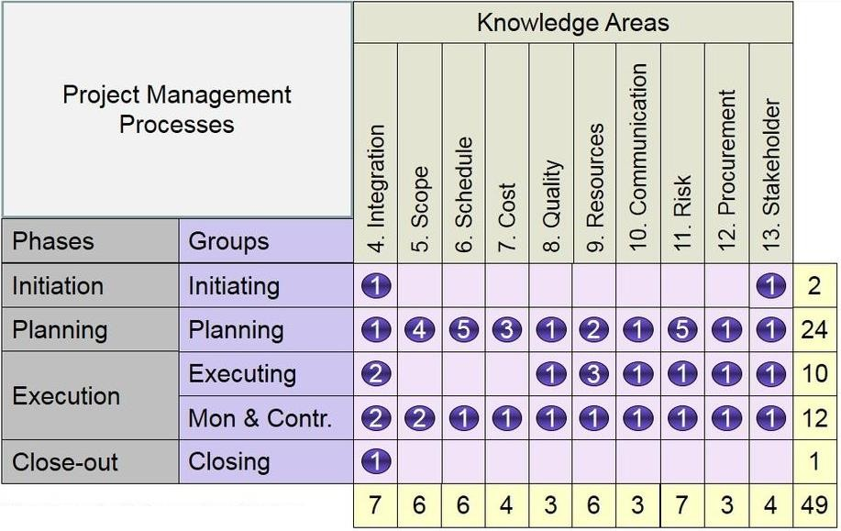

Overview

Slide 12
Overview
All process groups can be conducted in a each project phase.
It is not Project life cycle Phases
Has clear dependencies
In-depended of application area or Industry focus.
Large complex projects are split into the phases.
Initiation processes carried out in each phases

Slide 13
Initiating Process Group
It define a new project or a new phase of an existing project by obtaining authorization to start the project or phase
New Project or Project Phase
Project Manager is selected
Project charter is approved
Scope is Defined
Finance /budget is
committed
Stakeholders are identified
Stakeholder expectations &
understood

Slide 14
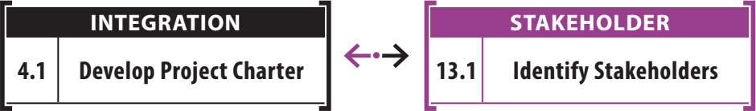
Initiating Process Group
There are two processes in this process group.

Slide 15
Initiating Process Group
Steps
Select project manager
Determine company culture and existing system
Collect processes, procedure and historical information
Divide large projects into phases
Understand the business
case
Uncover initial requirements, assumptions, risks, constraints, and existing agreements
Assess project and product feasibility within the given constraints
Create measureable objectives
Develop project charter
➔ Next slide

Slide 16
Initiating Process Group
Steps
Identify stakeholder and determine their expectations, influence and impact
Request changes
Develop assumption log
Develop stakeholder
register

Slide 17
Planning Process Group
It is the place where the PM, project teams decides what they want, how to do, when to do, who to do, money needed, time needed and so on.
Establish scope
Refine objectives
Defining products to be produced
Define work required
Sequencing work (schedule)
Estimating the resource( effort) & finalize schedule
Estimating costs (budget)

Slide 18
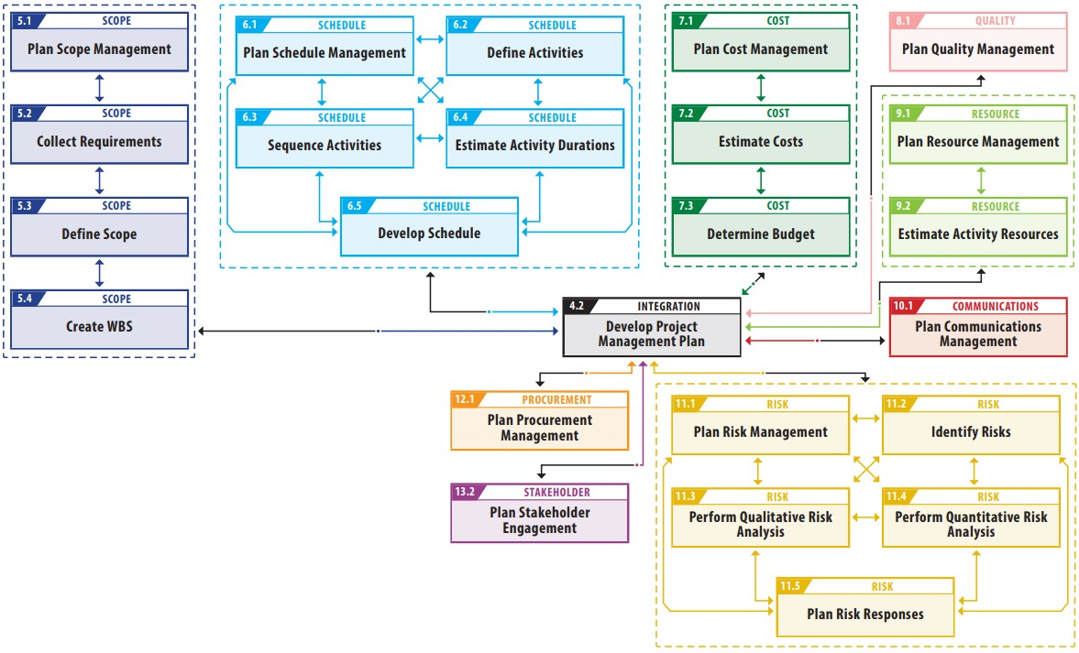
Planning Process Group

Slide 19
Planning Process Group
Steps
Determine development approach, life cycle and how you will plan for each knowledge area
Determine and prioritize
requirements
Create project scope statement
Assess what to purchase and
create procurement documents
Determine planning team
Create WBS and WBS Dictionary
Create activity list
Create network diagram
Estimate resource requirements
Estimate duration and cost
Determine critical path
Develop schedule
Develop budget
➔ Next slide

Slide 20
Planning Process Group
Steps
Determine quality standards, processes and metrics
Determine team charter and
all roles and responsibilities
Plan communications and stakeholder engagement
Perform risk identification qualitative and quantitative risk analysis, risk response planning
Go back - iteration
Finalize procurement strategy and
documents
Create change and configuration management plan
Finalize all management plans
Develop realistic and sufficient project mgnt plan and baseline
Gain formal approval of the plan
Hold kickoff meeting
Request changes

Slide 21
Executing Process Group
Processes performed to complete work defined in PMP to
satisfy project specification.
Directing and managing project
execution
Establishing and manage the project team.
Coordinating people and
resources
Monitoring team performance
Procurement
Distributing information
Performing quality assurance activities

Slide 22

Executing Process Group

Slide 23
Executing Process Group
Steps
Execute work according to the PM Plan
Produce product deliverables (product scope)
Gather work performance data
Request changes
Implement only approved
changes
Continuously improve; perform progressive elaboration
Follow processes
Determine whether quality plan and process are correct and effective
Perform quality audits and issue
quality report
Acquire final team and physical resource
Manage people
Evaluate team and individual performance; provide training
➔ Next slide

Slide 24
Executing Process Group
Steps
Hold team building activities
Give recognition and rewards
Use issue logs
Facilitate conflict resolution
Release resource as work is
completed
Send and receive information
and solicit feedback
Report on project performance
Facilitate stakeholder engagement and manage expectation
Hold meetings
Evaluate sellers; negotiate and contract with sellers
Use and share project knowledge
Executing contingency plan
Update PM plan and project
documents

Slide 25
Monitoring & Controlling Process Group
Those processes required to track, review, and regulate the progress and performance of the project; identify any areas in which changes to the plan are required; and initiate the corresponding changes
Involves tracking, reviewing, and
regulating project progress
Includes status reporting, progress measurement, and forecasting
Reports on scope, schedule, cost,
resources, quality, and risks
Controls project and project
document changes
Includes control of scope, schedule, costs, and risks
Formalizes acceptance of deliverables (called scope verification)
Records quality control results

Slide 26

Monitoring & Controlling Process Group

Slide 27
Monitoring & Controlling Process Group
Steps
Take action to monitor and
control the project
Measure performance against the performance measurement baseline
Measure performance against other metrics in the PM plan
Analyze and evaluate
performance
Determine if variances warrant a corrective action or other change request(s)
Influence the factors that cause
changes
Request changes
Perform integrated change control
Approve or reject changes
Update the PM plan and project documents
Inform stakeholders of the results of change requests
➔ Next slide

Slide 28
Monitoring & Controlling Process Group
Steps
Monitor stakeholder
engagement
Confirm configuration compliance
Create forecasts
Gain acceptance of interim deliverables from the customer
Perform quality control
Perform risk review, reassessments, and audits
Manage, evaluate and close procurements
Evaluate use of physical
resources

Slide 29
Closing Process Group
Processes performed to terminate formally all activities of a project or project phase, & transfer of completed product to others or to close a cancelled project.
Obtaining acceptance by the customer or sponsor (approval to close).
Releasing people and resources.
Reporting on team performance and lessons learned
Updating or finalizing documents, project records, and results.
Close procurements.
Storing or archiving information.
Formally close project or
phase

Slide 30
Closing Process Group

Slide 31
Closing Process Group
Steps
Confirm work is done to
requirement
Complete final procurement closure
Gain final acceptance of
product
Complete final closure
Hand-off completed product
Solicit customer’s feedback about
the project
Complete final performance reporting
Index and archive records
Gather final lessons learned and update knowledge bases.

Slide 32



It’s true
Don’t try to remember processes
Try to understand each process
Try explain it to others … It will firm your understanding

Slide 33
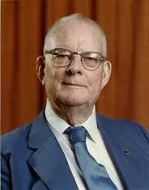
W. Edwards Deming
“If you can’t describe what you are doing as a process, you don’t know what you’re
doing”

Slide 34
3. 10 Knowledge Areas
35

Slide 35
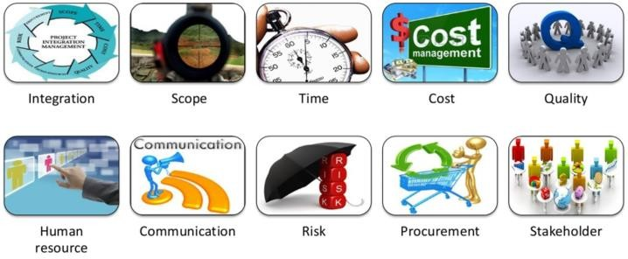
Overview
Area of project management defined by its knowledge requirements & described in terms of its component processes, practices, inputs, outputs, tools, and techniques

Slide 36
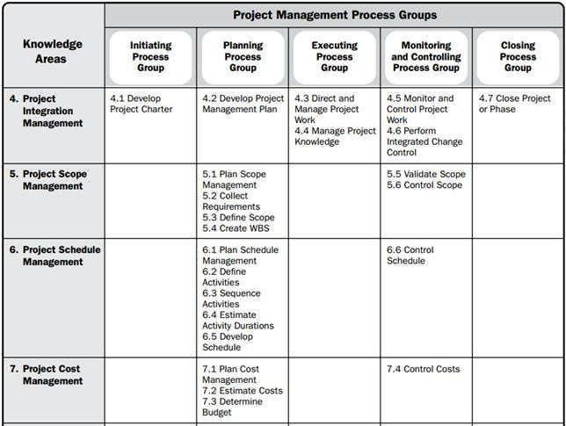
Overview

Slide 37
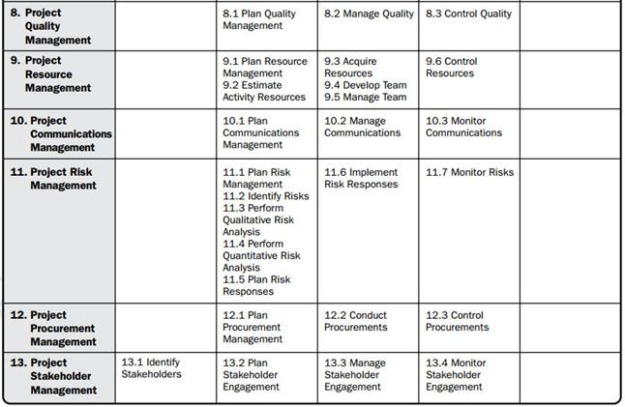
Overview

Slide 38
Summary
What is done during each of the project management process groups
Initiating
Planning
Executing
Monitoring and Controlling
Closing
What you do not do but should do in your real world during each of the project management process groups.

Slide 39
Next Objectives
Integration management
process
Integrated change control
Process for making changes
Project management plan
Project charter
Business case
Project selection
Project documents
Corrective action
Prevention action
Defect repair
Project manager’s role as integrator
Constraints and assumptions
More…

